Slide 1
Reliability

Slide 2
How do we know?
How do we know scores actually represent the characteristic/construct you are trying to measure? Especially when it is something not directly observable? (memory, depression etc.).
1) conduct research using the measure
2) Demonstrate and check that they work
An informal example
  Jim wants to start working out to put on muscle, and has been working out for the past 3 months. Jim looks bigger, he’s had to start buying larger shirts, and his friends all comment that he looks bigger. If Jim weighs himself and the scale said he had gained 20 pounds, that would make sense. If it said he had lost 20 pounds, Jim probably wouldn’t use that scale anymore.
Evaluate your measure!

Slide 3

Reliability
Reliability – refers to the consistency of a measure.
There are three main types of consistency:
  Test-retest reliability
  Internal consistency
  Inter-rater reliability

Slide 4
Test-retest reliability
When scores are assumed to be static over time, we should be able to measure them multiple times and get similar scores.
Intelligence as an example.
  50 people take 2 online IQ tests.
  Both 10 question quizzes found on the internet.
  Take them both at two time points.

Slide 5
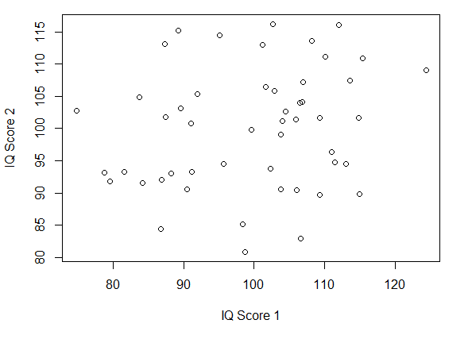
Test-retest reliability
Test # 1

Slide 6
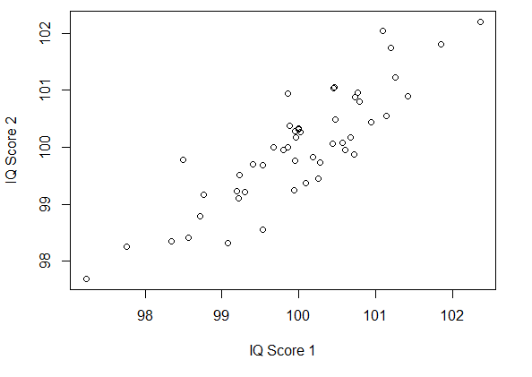
Test-retest reliability
Test # 2

Slide 7
Internal consistency
Internal consistency – the consistency of people’s responses across the items on a multiple-item measure.
Lots of measures have multiple items/questions
  They should all reflect the same underlying construct.
  So scores on individual items, not just the overall construct, should be correlated with each other.
Example: Purpose in Life Scale
  My life is: very worthwhile
  In thinking of my life: I always see reasons for being here
  I am a very responsible person
  I have discovered a satisfying life purpose
  I enjoy historical fiction books

Slide 8
Internal consistency
Question 1
Split-half correlation
Cronbach’s α
  The mean of all possible split-half correlations for a given set of items
  .8 indicates good internal consistency
Question 2
Questions 1,2,3,4
Question 3
Question 4
r = .92
Question 5
Question 6
Questions 5,6,7,8
Question 7
Question 8

Slide 9

Inter-rater reliability
Inter-rater reliability – the extent to which different observers are consistent in their judgments.
Some measures require judgments on the part of an observer or rater.
Bandura’s BoBo’s (Bandura, 1963)
Cronbach’s α (Cohen’s κ)

